Slide 1

Chapter 6
Slides by
John
Loucks
St. Edward’s
University
Continuous Probability Distributions

Slide 2
Contents
f (x)
Exponential
Uniform Probability Distribution
Normal Probability Distribution
Exponential Probability Distribution
x
Uniform
f (x)
Normal
f (x)
x
x

Slide 3
Continuous Probability Distributions
A continuous random variable can assume any value in an interval on the real line or in a collection of intervals.
It is not possible to talk about the probability of the random variable assuming a particular value.
Instead, we talk about the probability of the random variable assuming a value within a given interval.

Slide 4
Continuous Probability Distributions
The probability of the random variable assuming a value within some given interval from x₁ to x₂ is defined to be the area under the graph of the probability density function between x₁ and x₂.
f (x)
Exponential
Uniform
f (x)
Normal
f (x)
x₂
x
x₁
x
x₁
x₂
x
x₁
x₂

Slide 5
Uniform Probability Distribution
A random variable is uniformly distributed whenever the probability is proportional to the interval’s length.
The uniform probability density function is:
f (x) = 1/(b – a) for a < x < b
= 0 elsewhere
where: a = smallest value the variable can assume
b = largest value the variable can assume

Slide 6
Uniform Probability Distribution
Expected Value of x
E(x) = (a + b)/2
Variance of x
Var(x) = (b - a)²/12

Slide 7
Uniform Probability Distribution
Example: Slater's Buffet
Slater’s customers are charged for the amount of salad they take. Sampling suggests that the amount of salad taken is uniformly distributed between 5 ounces and 15 ounces.

Slide 8
Uniform Probability Distribution
Uniform Probability Density Function
f(x) = 1/10 for 5 < x < 15
= 0 elsewhere
where:
x = salad plate filling weight

Slide 9
Uniform Probability Distribution
Expected Value of x
E(x) = (a + b)/2
= (5 + 15)/2
= 10
Variance of x
Var(x) = (b - a)²/12
= (15 – 5)²/12
= 8.33

Slide 10
Uniform Probability Distribution
Salad Plate Filling Weight
f(x)
1/10
x
0
5
10
15
Salad Weight (oz.)

Slide 11
Uniform Probability Distribution
What is the probability that a customer
will take between 12 and 15 ounces of salad?
f(x)
P(12 < x < 15) = 1/10(3) = .3
1/10
x
0
5
10
12
15
Salad Weight (oz.)

Slide 12
Normal Probability Distribution
The normal probability distribution is the most important distribution for describing a continuous random variable.
It is widely used in statistical inference.
It has been used in a wide variety of applications including:
Heights of people
Amounts of rainfall
Test scores
Scientific measurements
Abraham de Moivre, a French mathematician, published The Doctrine of Chances in 1733.
He derived the normal distribution.

Slide 13
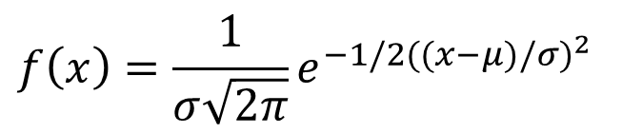
Normal Probability Distribution
Normal Probability Density Function
$$f\left(x\right)=\frac{1}{σ\sqrt{2π}}e^{−1/2((x−μ{)/σ)}^{2}}$$
where:
μ = mean
σ = standard deviation
π = 3.14159
e = 2.71828

Slide 14
Normal Probability Distribution
Characteristics
The distribution is symmetric; its skewness measure is zero.
x

Slide 15
Normal Probability Distribution
Characteristics
The entire family of normal probability distributions is defined by its mean μ and its standard deviation σ .
Standard Deviation σ
x
Mean μ

Slide 16
Normal Probability Distribution
Characteristics
The highest point on the normal curve is at the mean, which is also the median and mode.
x

Slide 17
Normal Probability Distribution
Characteristics
The mean can be any numerical value: negative, zero, or positive.
x
-10
0
25

Slide 18
Normal Probability Distribution
Characteristics
The standard deviation determines the width of the
curve: larger values result in wider, flatter curves.
σ = 15
σ = 25
x

Slide 19
Normal Probability Distribution
Characteristics
Probabilities for the normal random variable are given by areas under the curve. The total area under the curve is 1 (.5 to the left of the mean and
.5 to the right).
.5
.5
x

Slide 20
Normal Probability Distribution
Characteristics (basis for the empirical rule)
68.26% of values of a normal random variable
are within +/- 1 standard deviation of its mean.
95.44% of values of a normal random variable
are within +/- 2 standard deviations of its mean.
99.72% of values of a normal random variable
are within +/- 3 standard deviations of its mean.

Slide 21
Normal Probability Distribution
Characteristics (basis for the empirical rule)
99.72%
95.44%
68.26%
x
μ
μ + 3σ
μ – 3σ
μ – 1σ
μ + 1σ
μ – 2σ
μ + 2σ

Slide 22

Standard Normal Probability Distribution
Characteristics
A random variable having a normal distribution with a mean of 0 and a standard deviation of 1 is said to have a standard normal probability distribution.

Slide 23
Standard Normal Probability Distribution
Characteristics
The letter z is used to designate the standard normal random variable.
σ = 1
z
0

Slide 24
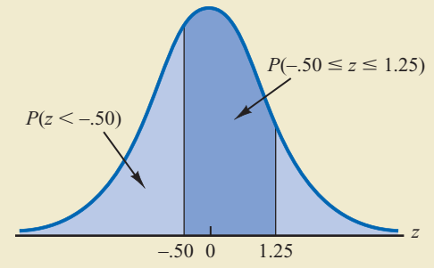
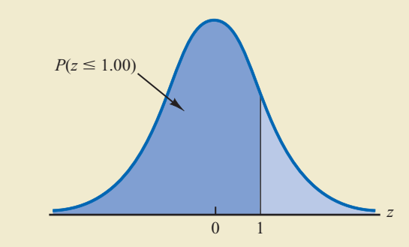
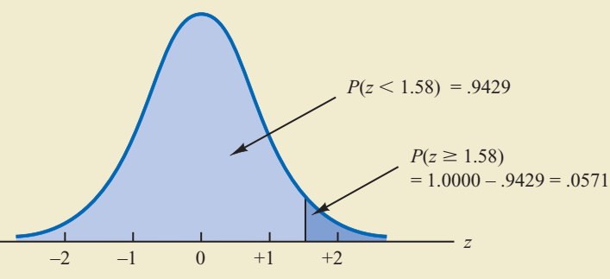
Standard Normal Probability Distribution
Three types of probability calculation

Slide 25
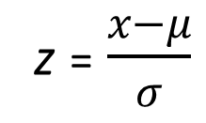
Standard Normal Probability Distribution
Converting to the Standard Normal Distribution
z = $\frac{x−μ}{σ}$
We can think of z as a measure of the number of standard deviations x is from μ.

Slide 26
Standard Normal Probability Distribution
Example: Pep Zone
Pep Zone sells auto parts and supplies including a popular multi-grade motor oil. When the stock of this oil drops to 20 gallons, a replenishment order is placed. The store manager is concerned that sales are being lost due to stockouts while waiting for a replenishment order.
It has been determined that demand during replenishment lead-time is normally distributed with a mean of 15 gallons and a standard deviation
of 6 gallons.
The manager would like to know the probability of a stockout during replenishment lead-time. In other words, what is the probability that demand during lead-time will exceed 20 gallons?
P(x > 20) = ?

Slide 27
Standard Normal Probability Distribution
Solving for the Stockout Probability
Step 1: Convert x to the standard normal distribution.
z = (x - μ)/σ
= (20 - 15)/6
= .83
Step 2: Find the area under the standard normal curve to the left of z = .83.

Slide 28
Standard Normal Probability Distribution
Solving for the Stockout Probability
Area = .7967
Area = 1 - .7967
= .2033
z
0
.83

Slide 29
Standard Normal Probability Distribution
Cumulative Probability Table for the Standard Normal Distribution
z
.00
.01
.02
.03
.04
.05
.06
.07
.08
.09
.
.
.
.
.
.
.
.
.
.
.
.5
.6915
.6950
.6985
.7019
.7054
.7088
.7123
.7157
.7190
.7224
.6
.7257
.7291
.7324
.7357
.7389
.7422
.7454
.7486
.7517
.7549
.7
.7580
.7611
.7642
.7673
.7704
.7734
.7764
.7794
.7823
.7852
.8
.7881
.7910
.7939
.7967
.7995
.8023
.8051
.8078
.8106
.8133
.9
.8159
.8186
.8212
.8238
.8264
.8289
.8315
.8340
.8365
.8389
.
.
.
.
.
.
.
.
.
.
.
P(z < .83) = .7967

Slide 30
Standard Normal Probability Distribution
Solving for the Stockout Probability
Step 3: Compute the area under the standard normal
curve to the right of z = .83.
P(z > .83) = 1 – P(z < .83)
= 1- .7967
= .2033

Slide 31
Standard Normal Probability Distribution
If the manager of Pep Zone wants the probability of a stockout during replenishment lead-time to be no more than .05, what should the reorder point be?
(Hint: Given a probability, we can use the standard normal table in an inverse fashion to find the corresponding z value.)

Slide 32
Standard Normal Probability Distribution
Solving for the Reorder Point
Area = .9500
Area = .0500
z
0
z_{.05}

Slide 33
Standard Normal Probability Distribution
Solving for the Reorder Point
Step 1: Find the z-value that cuts off an area of .05 in the right tail of the standard normal distribution.
z
.00
.01
.02
.03
.04
.05
.06
.07
.08
.09
.
.
.
.
.
.
.
.
.
.
.
1.5
.9332
.9345
.9357
.9370
.9382
.9394
.9406
.9418
.9429
.9441
1.6
.9452
.9463
.9474
.9484
.9495
.9505
.9515
.9525
.9535
.9545
1.7
.9554
.9564
.9573
.9582
.9591
.9599
.9608
.9616
.9625
.9633
1.8
.9641
.9649
.9656
.9664
.9671
.9678
.9686
.9693
.9699
.9706
1.9
.9713
.9719
.9726
.9732
.9738
.9744
.9750
.9756
.9761
.9767
.
.
.
.
.
.
.
.
.
.
.
We look up the complement of the tail area (1 - .05 = .95)

Slide 34
Standard Normal Probability Distribution
Solving for the Reorder Point
Step 2: Convert z_{.05} to the corresponding value of x.
x = μ + z_{.05}σ
= 15 + 1.645(6)
= 24.87 or 25
A reorder point of 25 gallons will place the probability
of a stockout during lead time at (slightly less than) .05.

Slide 35
Standard Normal Probability Distribution
Solving for the Reorder Point
By raising the reorder point from 20 gallons to 25 gallons on hand, the probability of a stockout decreases from about .20 to .05.
This is a significant decrease in the chance that Pep Zone will be out of stock and unable to meet a customer’s desire to make a purchase.

Slide 36
Using Excel to Compute Normal Probabilities
Excel has two functions for computing cumulative probabilities and x values for any normal distribution:
NORM.DIST is used to compute the cumulative probability given an x value.
NORM.INV is used to compute the x value given a cumulative probability.

Slide 37
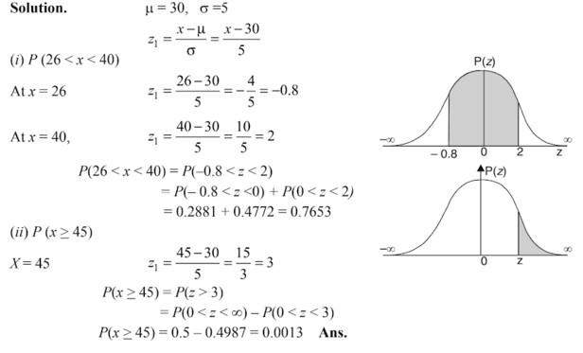
Normal Distribution – Question for Practice
X is a normal random variable with mean 30 and standard deviation 5. Find the probability that:
(i) 26 < x < 40 (ii) x >= 45

Slide 38
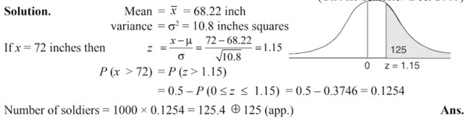
Normal Distribution – Question for Practice
Assume mean height of soldiers to be 68.22 inches with a variance of 10.8 inches square. How many soldiers in a regiment of 1,000 would you expect to be over 6 feet tall, assuming it is normal distribution.

Slide 39
Normal Distribution – Question for Practice
Automobile repair costs continue to rise with the average cost now at $367 per repair (U.S. News & World Report website, January 5, 2015). Assume that the cost for an automobile repair is normally distributed with a standard deviation of $88. Answer the following questions about the cost of automobile repairs.
a. What is the probability that the cost will be more than $450?
b. What is the probability that the cost will be less than $250?
c. What is the probability that the cost will be between $250 and $450?
d. If the cost for your car repair is in the lower 5% of automobile repair charges, what is your cost?

Slide 40
Normal Distribution – Question for Practice
The average return for large­-cap domestic stock funds over the three years 2009–2011 was 14.4% (AAII Journal, February, 2012). Assume the three-­year returns were normally distributed across funds with a standard deviation of 4.4%.
a. What is the probability an individual large­-cap domestic stock fund had a three-year return of at least 20%?
b. What is the probability an individual large­-cap domestic stock fund had a three-year return of 10% or less?
c. How big does the return have to be to put a domestic stock fund in the top 10% for the three-­year period?

Slide 41
Exponential Probability Distribution
The exponential probability distribution is useful in describing the time it takes to complete a task. It is typically used to model time intervals between “random events”.
The exponential random variables can be used to describe:
Time between vehicle arrivals at a toll booth
Time required to complete a questionnaire
Distance between major defects in a highway
Like the Poisson distribution, it also assumes that the arrivals are independent from one another.

Slide 42
Relationship between the Poisson and Exponential Distributions
The Poisson distribution
provides an appropriate description
of the number of occurrences
per interval.
The exponential distribution
provides an appropriate description
of the length of the interval
between occurrences.

Slide 43
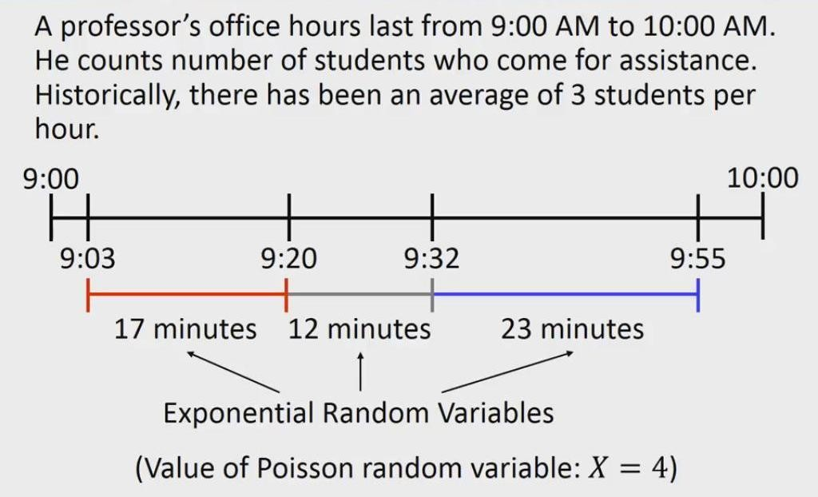
Relationship between the Poisson and Exponential Distributions

Slide 44
Exponential Probability Distribution
A property of the exponential distribution is that the mean and standard deviation are equal.
The exponential distribution is skewed to the right. Its skewness measure is 2.

Slide 45
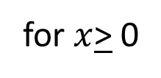
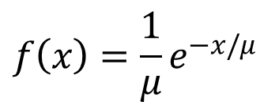
Exponential Probability Distribution
Density Function for the length of time between arrivals
$$f\left(x\right)=\frac{1}{μ}e^{−x/μ}$$
for $x$> 0
where: μ = expected value or mean time between arrivals
e = 2.71828
𝜆 = 1 / µ,
λ is mean numbers of arrivals per unit

Slide 46
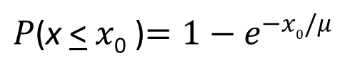
Exponential Probability Distribution
Cumulative Probabilities
$P$(x < $x$₀ )$=1−e^{−x_{0}/μ}$
where:
x₀ = some specific value of x

Slide 47
Exponential Probability Distribution
Example: Al’s Full-Service Pump
The time between arrivals of cars at Al’s full-service gas pump follows an exponential probability distribution with a mean time between arrivals of 3 minutes. Al would like to know the probability that the time between two successive arrivals will be 2 minutes or less.

Slide 48
Exponential Probability Distribution
Example: Al’s Full-Service Pump
f(x)
.4
P(x < 2) = 1 - 2.71828^{-2/3} = 1 - .5134 = .4866
.3
.2
.1
x
0 1 2 3 4 5 6 7 8 9 10
Time Between Successive Arrivals (mins.)

Slide 49
Exponential Probability Distribution
Example: Postal Clerk
Let X = amount of time (in minutes) a postal clerk spends with his/her customer. The time is known to have an exponential distribution with the average amount of time equal to 4 minutes. Find the probability that a clerk spends four to five minutes with a randomly selected customer.

Slide 50
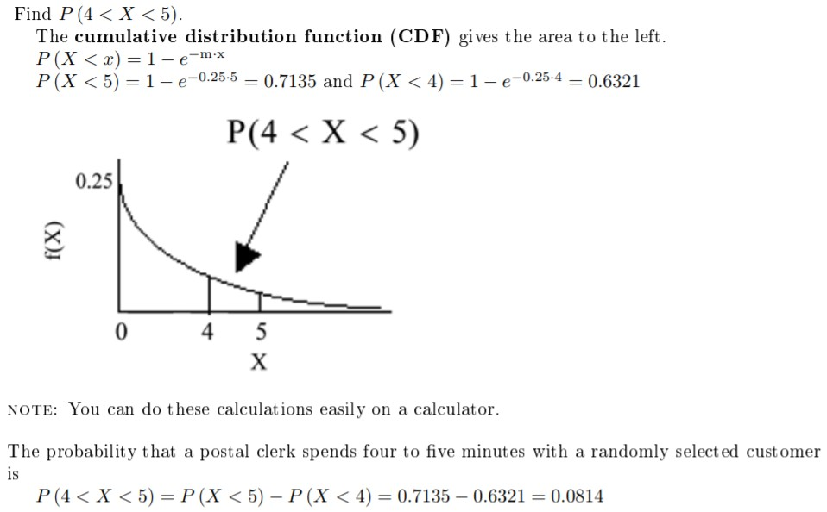
Exponential Probability Distribution
Example: Postal Clerk

Slide 51
Exponential Probability Distribution
Question: Bank ATM
Suppose that customers arrive at a bank’s ATM at a rate of 20 per hour. If a customer has just arrived, what is the probability that the next customer will arrive within 6 minutes (i.e., 0.1 hour)? What is the probability that the next customer will arrive within 3 minutes (i.e., 0.05 hour)?

Slide 52
End of Chapter 6

